Slide 1
Discover Music Concert
Friday, February 2, 2024
Dr. Paul-Elliott Cobbs, conductor

Slide 2
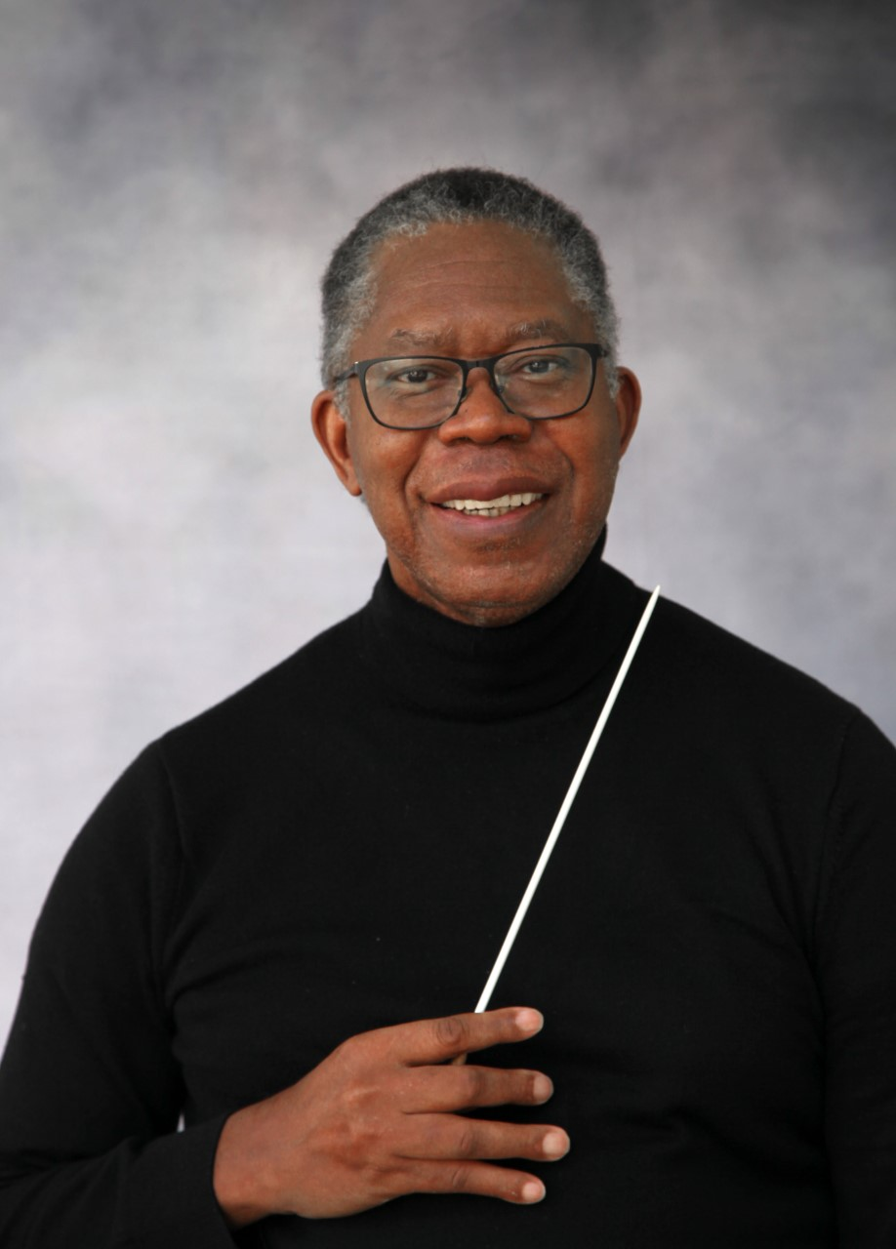
A message from the conductor...
Hello everyone!
I am Dr. Paul-Elliott Cobbs, conductor of the Tacoma Youth Symphony. The orchestra and I would like to welcome you to our Discover Music concert. Each musical selection we play will create a very exciting adventure, chosen just for you. All we need now is you and your wonderful imagination. See you soon!

Slide 3
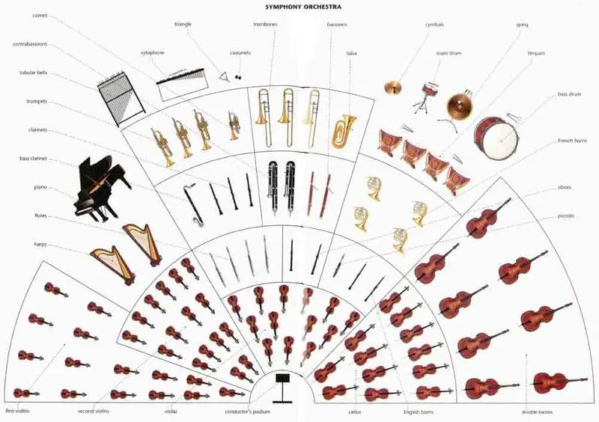
The full symphony orchestra!
There are four "families" that make up the symphony orchestra:
strings, woodwinds, brass, and percussion.

Slide 4
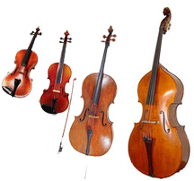
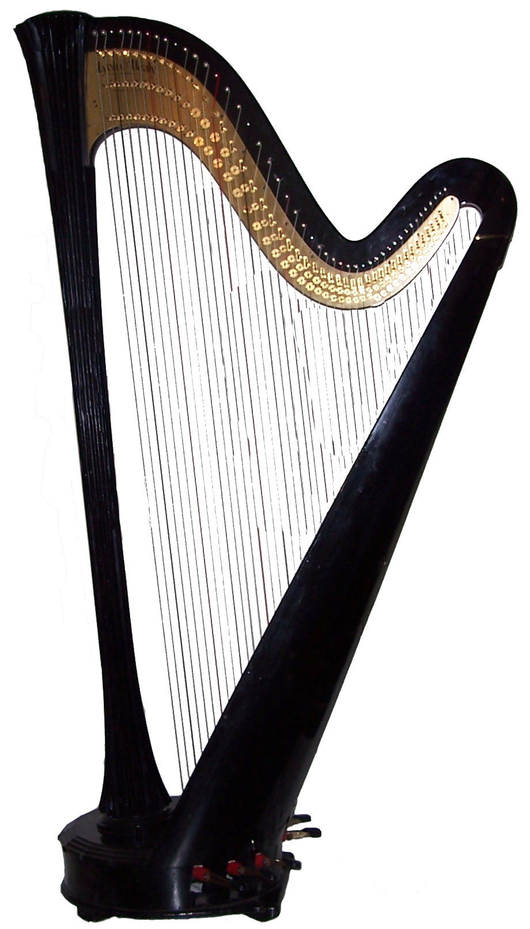
The String Family
Violin, Viola, Cello, Double Bass, and Harp

Slide 5
The sounds of the string family...

Slide 6
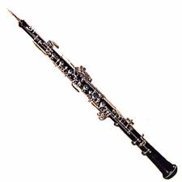
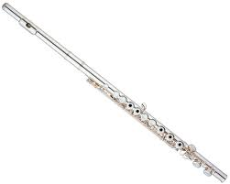
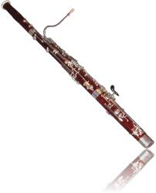
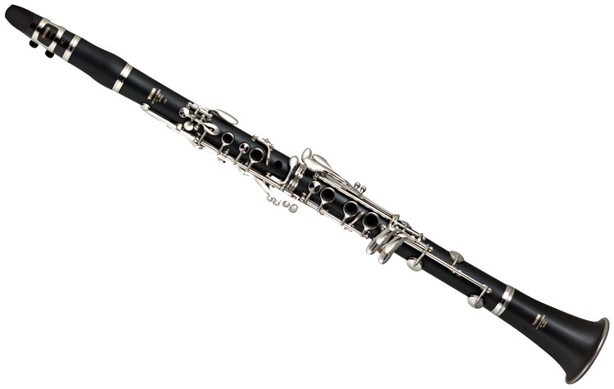
Flute
Oboe
Clarinet
Bassoon
The Woodwind Family

Slide 7
The sounds of a woodwind quintet...

Slide 8
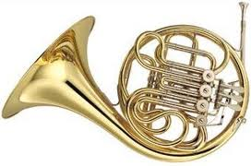
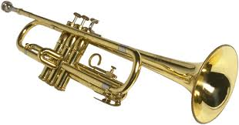
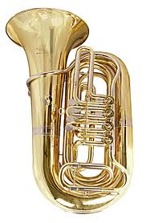
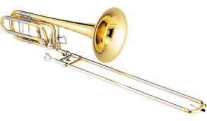
French Horn
Trumpet
Trombone
Tuba
The Brass Family

Slide 9
The sounds of the brass family...

Slide 10
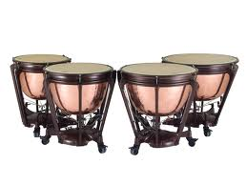
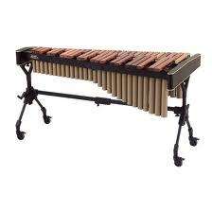
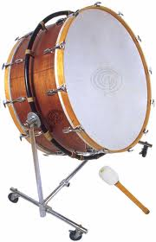
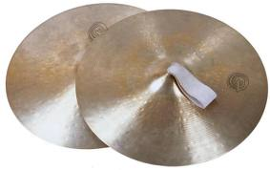
Timpani
Xylophone
Bass Drum
Cymbals
The Percussion Family
There are many instruments in the percussion family. Here are four instruments that you will see at the concert.

Slide 11
The Sounds of the Percussion Family...

Slide 12
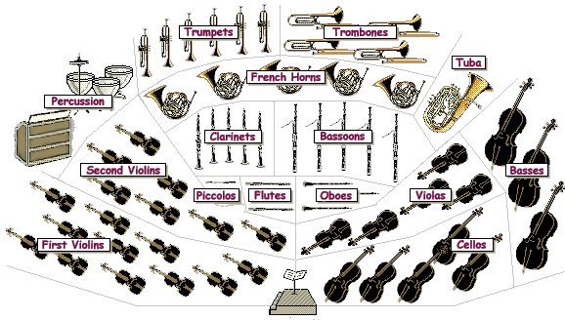
The full symphony orchestra seat-map.
This is how it looks when we put all of the instrument families together.

Slide 13
A video: “How do instruments make music?”

Slide 14
The Discover Music Program
Pirates of the Caribbean................................Klaus Badelt
Peter and the Wolf...................................Serge Prokofiev
Star Wars.....................................................John Williams

Slide 15
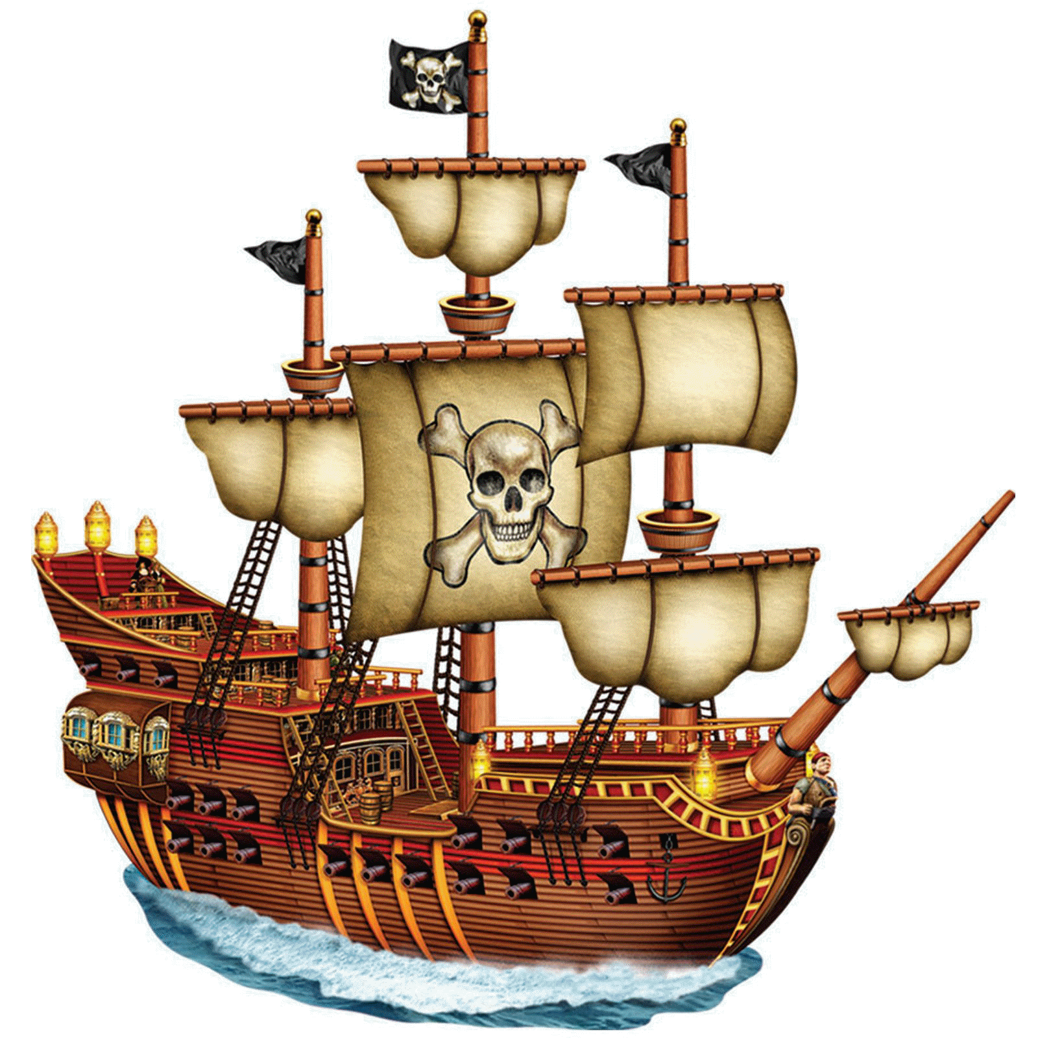
Pirates of the Caribbean
By: Klaus Badelt

Slide 16
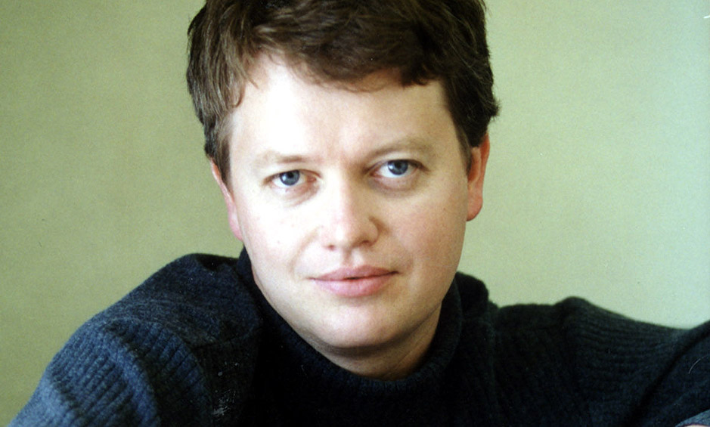
Klaus Badelt composed Pirates of the Caribbean.
Klaus Badelt was born in 1967.
He was born in Frankfurt, Germany and moved to the U.S. in 1998.
Badelt has written a wide variety of music for movies, television, and commercials.

Slide 17
Pirates of the Caribbean
The Curse of the Black Pearl
This music tells the story of Jack Sparrow and his pirate adventures!
While listening to this performance, see if you can hear the different instrument families. Some of the instruments tell very important parts of the story…use your imagination to make up your own pirate adventure!

Slide 18
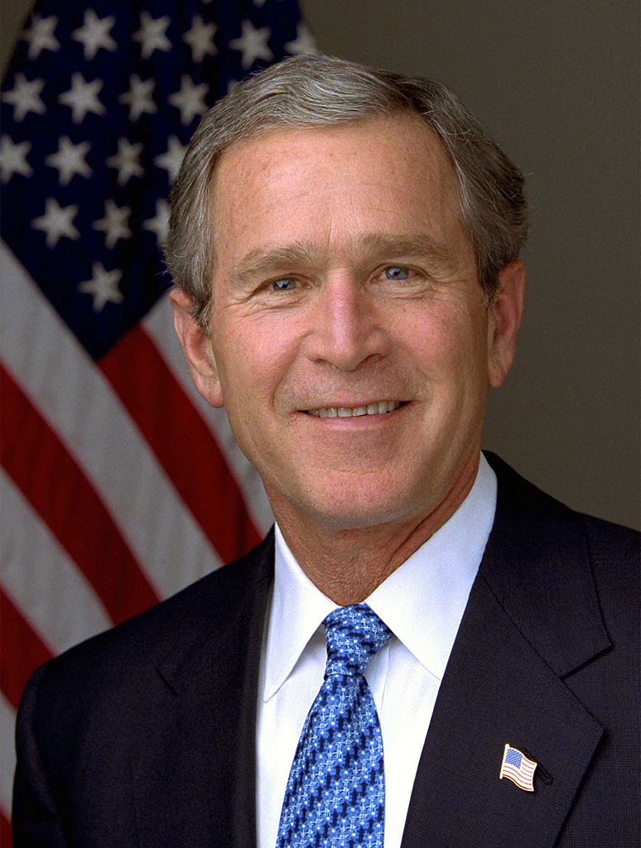
Pirates of the Caribbean was composed in 2003.
Here are a few events from 2003.
George W. Bush was the U.S. president.
The Department of Homeland Security begins operation.
A gallon of gas cost $1.83.
The iTunes music store is invented.

Slide 19
Star Wars
By: John Williams

Slide 20
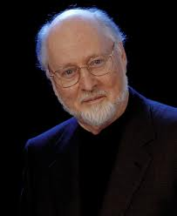
John Williams composed the music for the movie, Star Wars.
John Williams was born in 1932 in Queens, NY.
Williams is also a famous conductor and conducts orchestras around the world.
He is a very famous composer of movie music. Williams has written the music for E.T., Jurassic Park, Hook, Jaws, Indiana Jones, Home Alone, and the Harry Potter movies.

Slide 21
A long time ago, in a galaxy far, far away…
It is a period of civil war. Rebel spaceships, striking from a hidden base, have won their first victory against the evil Galactic Empire. During the battle, Rebel spies managed to steal secret plans to the Empire’s ultimate weapon, the Death Star, an armored space station with enough power to destroy an entire planet. Pursued by the Empire’s sinister agents, Princess Leia races home aboard her starship, custodian of the stolen plans that can save her people and restore freedom to the galaxy…
It is a period of civiIt is a period of civil war. Rebel spaceships, striking from a hidden base, have won their first victory against the evil Galactic Empire. During the battle, Rebel spies managed to steal secret plans to the Empire’s ultimate weapon, the Death Star, an armored space station with enough power to destroy an entire planet. Pursued by the Empire’s sinister agents, Princess Leia races home aboard her starship, custodian of the stolen plans that can save her people and restore freedom to the galaxy…
l war. Rebel spaceships, striking from a hidden base, have won their first victory against the evil Galactic Empire. During the battle, Rebel spies managed to steal secret plans to the Empire’s ultimate weapon, the Death Star, an armored space station with enough power to destroy an entire planet. Pursued by the Empire’s sinister agents, Princess Leia races home aboard her starship, custodian of the stolen plans that can save her people and restore freedom to the galaxy…

Slide 22
Star Wars - Conducted by Maestro Darth Vader!

Slide 23
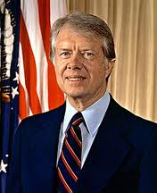
The music for Star Wars was composed in 1977.
Here are a few events from 1977.
Jimmy Carter succeeded Gerald Ford as the U.S. president.
Cell phones will be invented within the next two years.
The rings of the planet, Uranus, are discovered.
Apple II, the first personal computer, went on sale.

Slide 24
Peter and the Wolf
By:
Serge Prokofiev

Slide 25
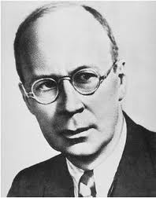
Serge Prokofiev composed Peter and the Wolf.
Serge Prokofiev was born in 1891 and lived until 1953.
He was one of Russia's greatest composers.
Prokoviev also was a pianist and conductor.
Prokofiev is considered a major composer of the 20th century.

Slide 26
The Characters of Peter and the Wolf
Bird - Flute
Cat - Clarinet
Duck - Oboe
Wolf - French Horn
Grandfather - Bassoon
Hunters - Timpani
Peter - Strings

Slide 27
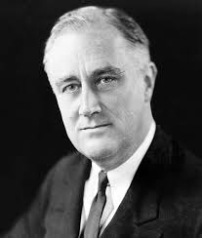
Peter and the Wolf was composed in 1936.
Here are a few events from 1936.
The president of the U.S. was Franklin Roosevelt
World War II will begin in the next few years.
Parking meters were invented this year.
The Hoover Dam is completed.

Slide 28
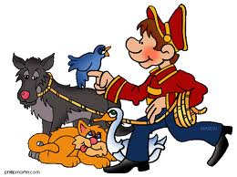
An introduction to the story of Peter and the Wolf
Peter lives in the country with his grandfather. His grandfather tells Peter not to play in the meadow because a wolf lives in the forest, but Peter goes into the meadow. He leaves the gate open and the duck goes too. Peter goes to the meadow to play, with the duck, bird and cat. The wolf comes out of the forest into the meadow and eats the duck. Peter is brave and with the help of the cat and bird, he catches the wolf. Hunters help him put the wolf into a cage. Grandfather is very surprised when he sees what Peter has done.
* This introduction was borrowed from Penguin Readers.

Slide 29
Helpful Links for Peter and the Wolf
Background and more sound examples
http://www.philtulga.com/Peter.html
Lesson Plans
https://www.mydso.com/dso-kids/for-teachers/resources-and-lesson-plans
A few other ideas…
http://thefantasticfive-hockmana.blogspot.com/2011/01/peter-and-wolf-mini-unit.html
https://midnightmusic.com/2016/02/31-fantastic-free-peter-and-the-wolf-resources/

Slide 30
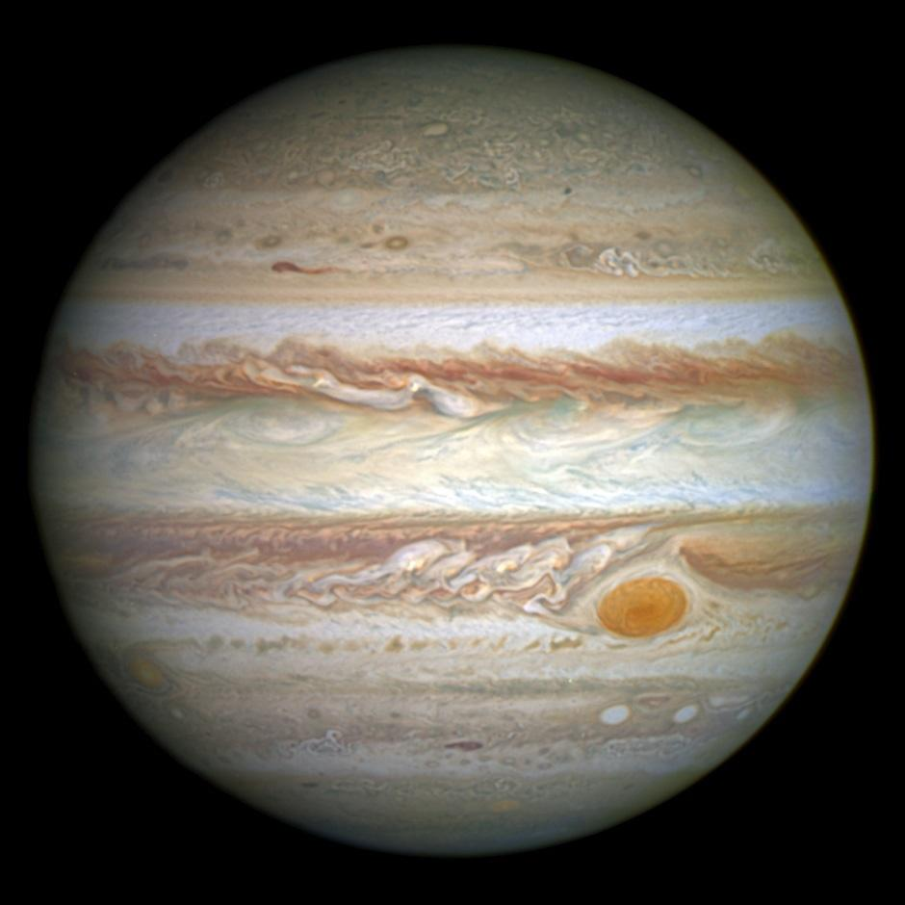
“Jupiter”
from The Planets
by Gustav Holst

Slide 31
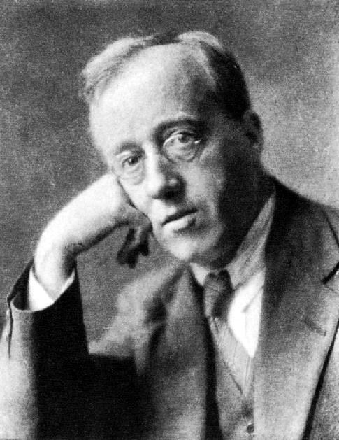
Gustav Holst composed Jupiter.
Gustav Holst lived from 1874-1934.
He was born in England, where he lived as a composer, teacher, and musician.
Holst was a shy man who did not welcome being famous.

Slide 32
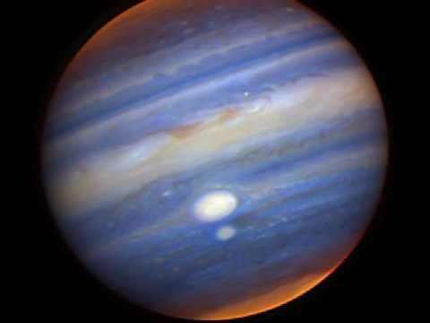
Jupiter performed by a symphony orchestra along with NASA images of the planet:

Slide 33
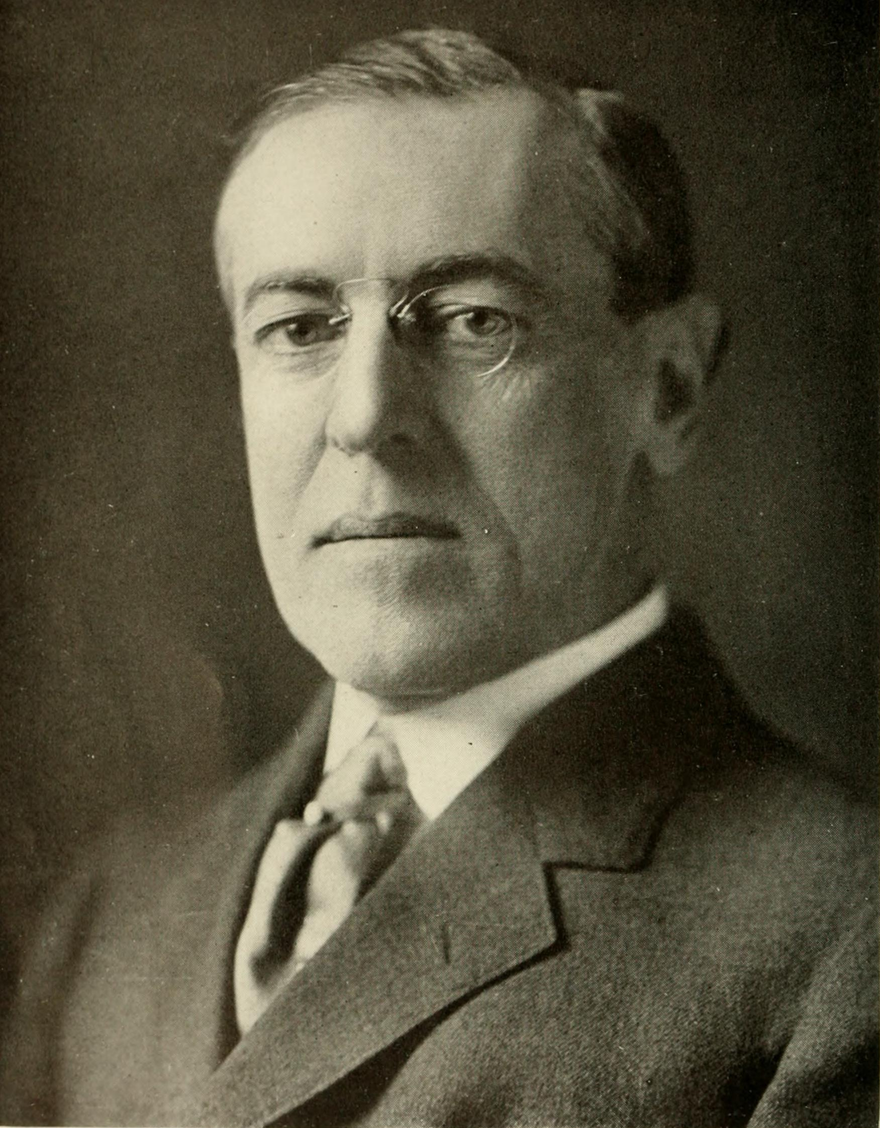
The music to Jupiter was composed between 1914-16.
Here are a few events from around that time.
Woodrow Wilson is president.
World War I began in 1914.
In 1915 Albert Einstein completes the general theory of relativity.
Traffic cones, hamburger buns, supermarkets, fortune cookies, Lincoln logs, and the lightswitch were all invented during this time.

Slide 34
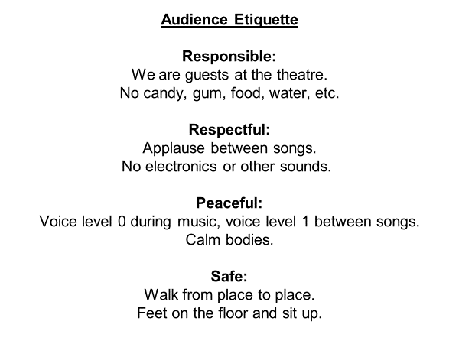
Revised by Penny Cramer

Slide 35
How do I know when the concert is going to begin?
First, the orchestra comes onstage and warms up.
Then, the student concertmaster (a violinist) comes to the podium and tunes the orchestra. The concertmaster asks the oboe to play the note "A" and all of the other instruments play their note “A” to make sure they all sound the same.
Once everyone is tuned and the concertmaster sits down, the conductor walks to the podium and begins the program.

Slide 36
Thanks so much for learning all about our Discover Music Concert.
We are looking forward to seeing
you in February!!!
Your friends,
The Tacoma Youth Symphony

Slide 38
Many resources were used in this presentation:
www.youtube.com
www.wikipedia.com
www.historyorb.com
Penguin Readers
Google Images

